Slide 1




Exploratory Data Analysis (EDA) - A Powerful Approach to Unlock Insights
Exploratory Data Analysis (EDA) is a crucial step in the machine learning process, enabling you to gain a deep understanding of your data, identify patterns, and uncover hidden insights that can significantly impact your model's performance.
By: Anushka Pateriya, Asmika Jain

Slide 2

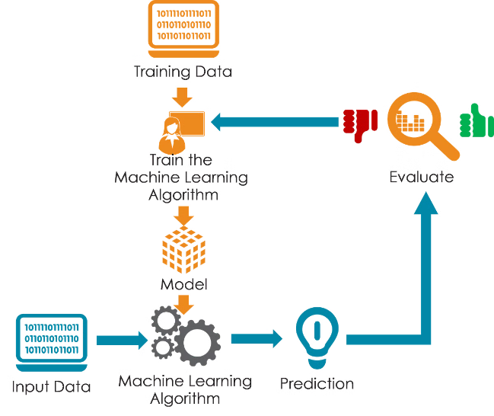
The Vital Role of EDA in Machine Learning
1
Understand Data
2
Identify Issues
EDA helps you explore the characteristics of your data, such as distributions, correlations, and relationships, allowing you to make informed decisions about feature engineering and model selection.
Through EDA, you can detect and address data quality issues, such as missing values, outliers, and inconsistencies, ensuring your models are built on clean and reliable data.
3
Refine Hypotheses
EDA enables you to formulate and refine your hypotheses, guiding your model development and iterative improvement process.

Slide 3

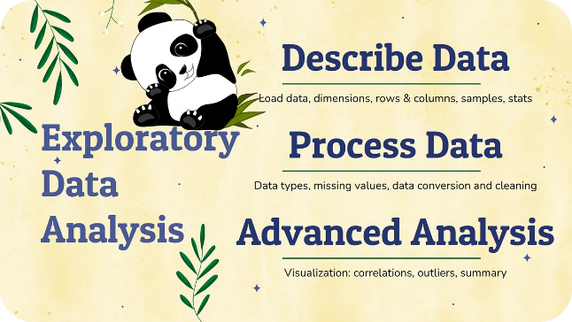
Key Steps in the EDA Process
1
Data Inspection
Examine the structure, features, and data types to understand the dataset's composition.
2
Univariate Analysis
Analyze the distribution and statistics of individual features to identify their characteristics.
3
Bivariate Analysis
Explore the relationships and correlations between pairs of features to uncover potential patterns.

Slide 4
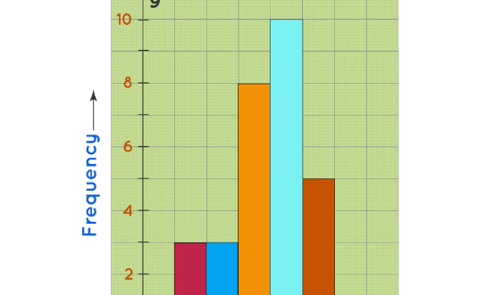
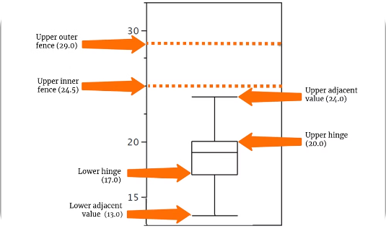
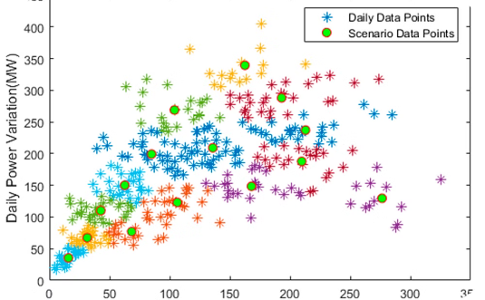
Visualizing Data Distributions
Histogram
Box Plot
Scatter Plot
Visualize the distribution of a single variable to understand its spread and central tendency.
Identify outliers, skewness, and the overall spread of a variable's distribution.
Examine the relationship between two variables and identify potential correlations.

Slide 5
Identifying Correlations and Relationships
Correlation Matrix
Scatter Plot Matrix
Heatmap
Visualize the pairwise correlations between features, providing insights into their linear relationships.
Explore the relationships between multiple variables simultaneously, uncovering patterns and potential multicollinearity.
Represent the correlation coefficients in a visually intuitive way, making it easier to identify strong relationships.

Slide 6

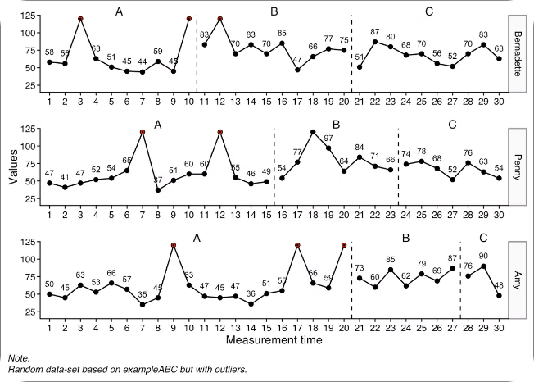
Handling Missing Data and Outliers
Missing Data Imputation
Outlier Detection
Employ techniques such as mean/median imputation, K-Nearest Neighbors, or more advanced methods to handle missing values.
Identify and address outliers using statistical methods, such as z-scores, Isolation Forests, or One-Class SVM.
Feature Engineering
Model Validation
Create new features or transform existing ones to better capture the underlying data structure and relationships.
Assess the impact of data cleansing and feature engineering on model performance through cross-validation.

Slide 7

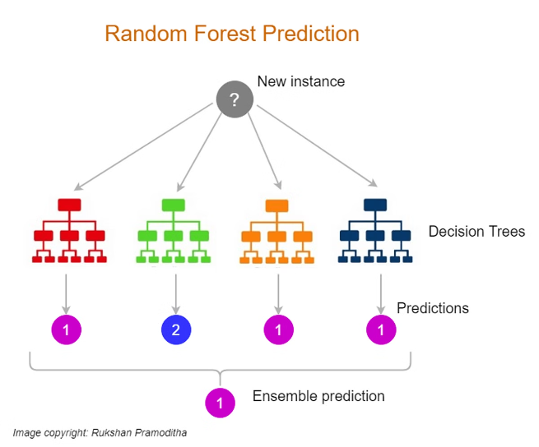
Introduction to Random Forest Classification
1
Ensemble Learning
Random Forest is an ensemble learning method that combines multiple decision trees to improve the model's predictive power and robustness.
2
Bootstrap Aggregation
Random Forest uses the Bagging technique, where each decision tree is trained on a random subset of the data, creating a diverse ensemble.
3
Feature Importance
The algorithm can provide insights into the relative importance of each feature, guiding feature selection and model interpretation.

Slide 8

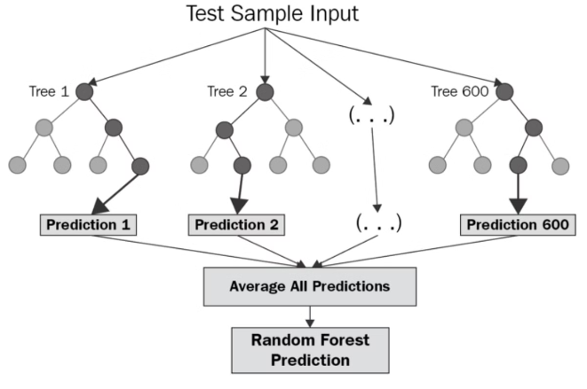




Advantages and Applications of Random Forest
High Accuracy
Robustness
Random Forest is a highly accurate classifier, often outperforming other algorithms, especially for complex, nonlinear problems.
The ensemble approach makes Random Forest resilient to overfitting and able to handle noisy or incomplete data.
Feature Importance
Versatility
The algorithm can identify the most influential features, providing valuable insights for feature engineering and model interpretation.
Random Forest can be applied to a wide range of classification and regression problems, making it a versatile tool in the data scientist's toolkit.

